Slide 1

Code Quality
Continuous Inspection of code Quality

Slide 2
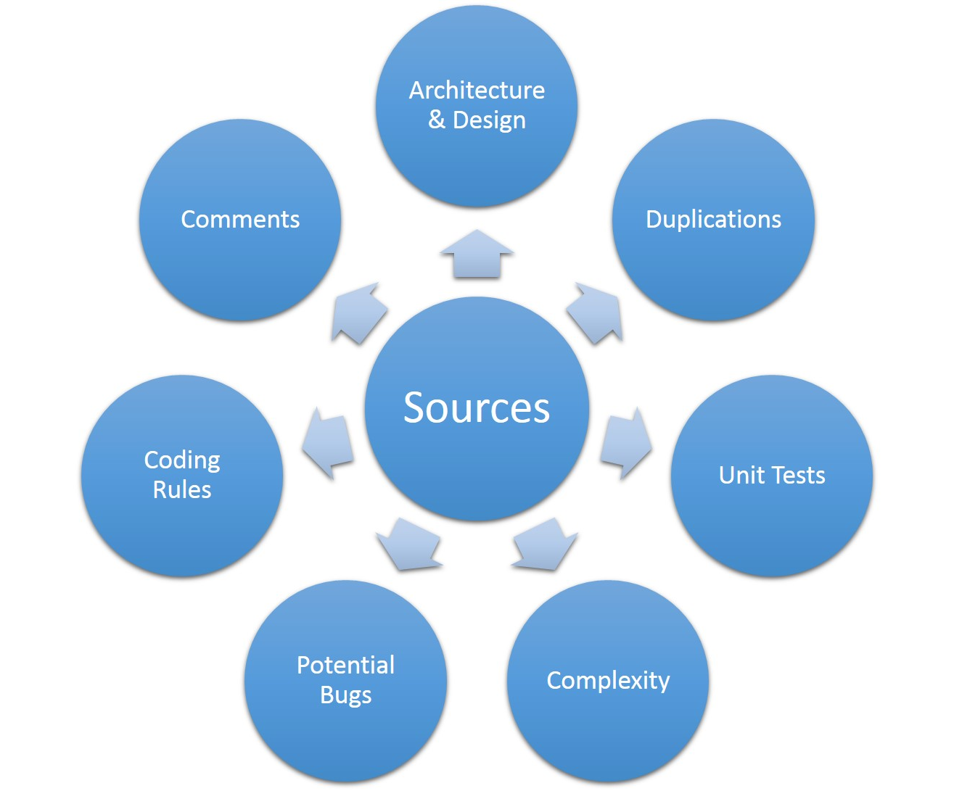
Objective
Coding Rules
Complexity
Duplicated Code
Potential Bugs
Test Coverage
Architecture Design
Comment

Slide 3
Sonar?
“Sonar is the central place to manage code quality, offering visual reporting on and across projects and enabling to replay the past to follow metric evolution”
Promotes Transparency
source : https://www.sonarqube.org/

Slide 4
What SonarQube is / does
An open web-based application platform to manage code quality
It is an automatic code review tool to detect bugs, vulnerabilities and code smells in code
Provide moment-in-time quality snapshots
Give trends of lagging and leading indicators
Tracks ‘developers’ seven deadly sins (Seven axes of quality)
An open web-based application platform to manage code quality
source : https://www.sonarqube.org/

Slide 5
How does it work?
Analyzes source code and byte code
Computes hundreds of metrics
Associates metrics with analysis snapshots
Shows the result in dashboards and widgets accessible by any browser.

Slide 6



… and for everyone

Slide 7
The Big Picture
The and reduce Technical Dept on an ongoing basis.
Engage all developers from project day #1
Get alerted when technical dept is beyond a threshold.

Slide 8

Who uses

Slide 9

Questions

Slide 10
References
http://www.sonarsource.org
SonarQube in Action

